Slide 1

Collecting and Analysing Outline Data
Ryan N. Felice

Slide 2
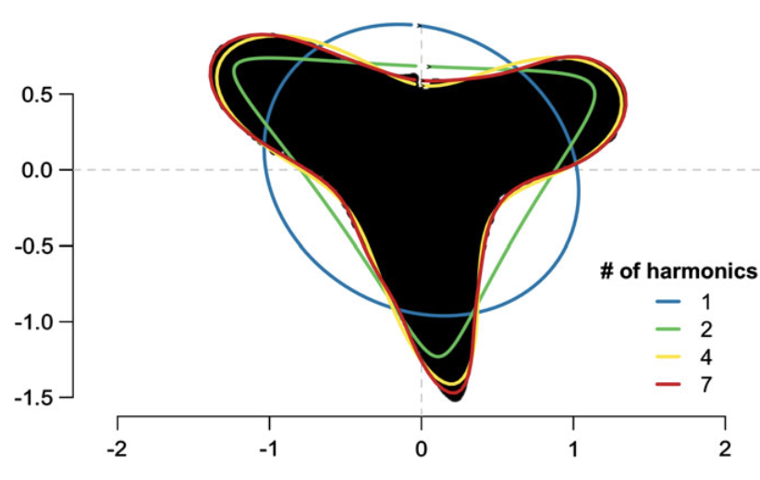
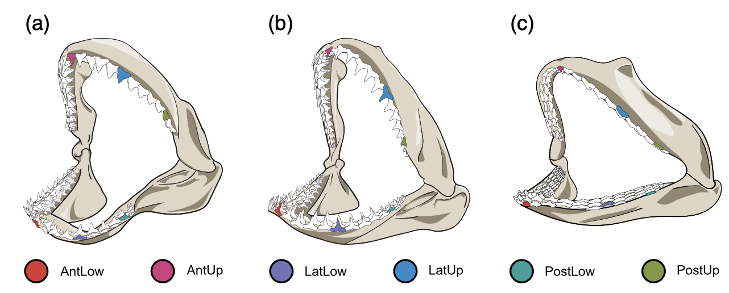
Cullen and Marshall 2019

Slide 3
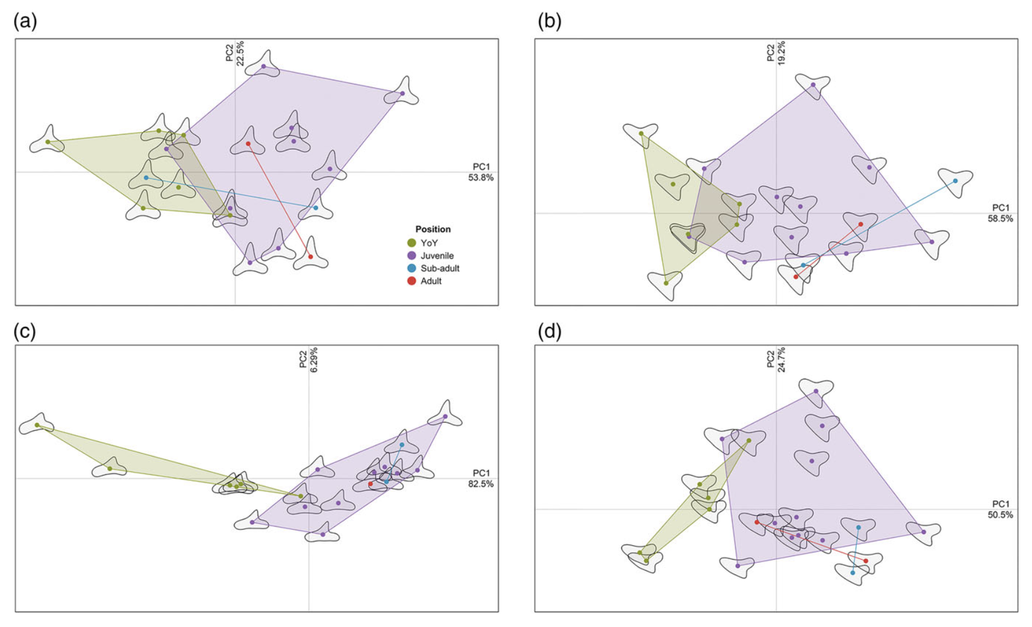

Slide 4
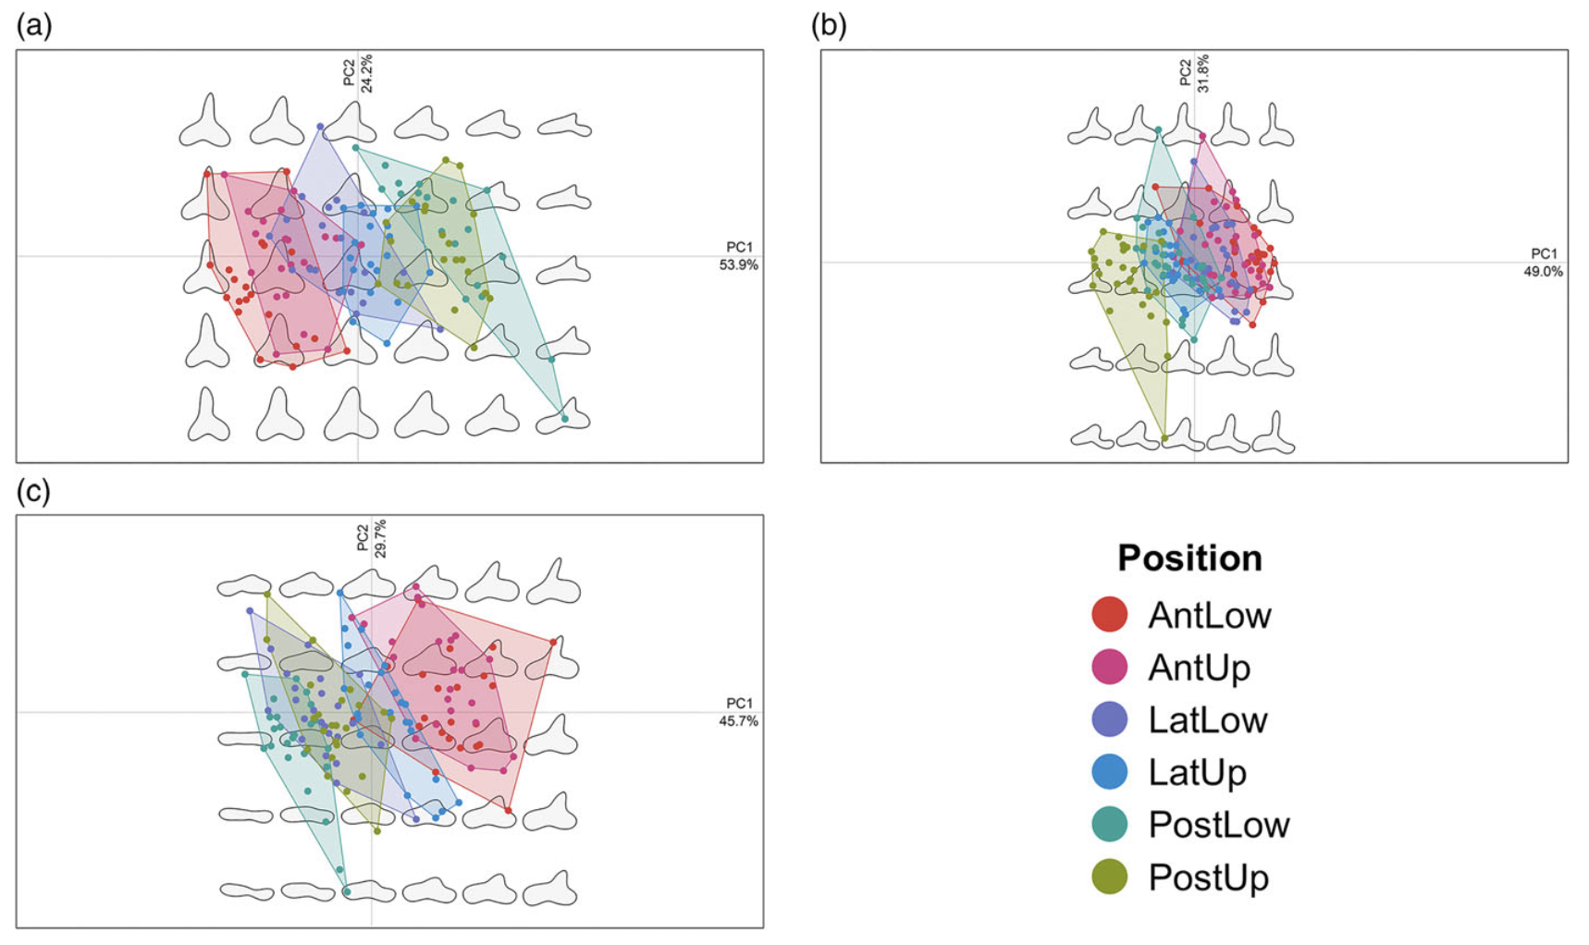

Slide 5
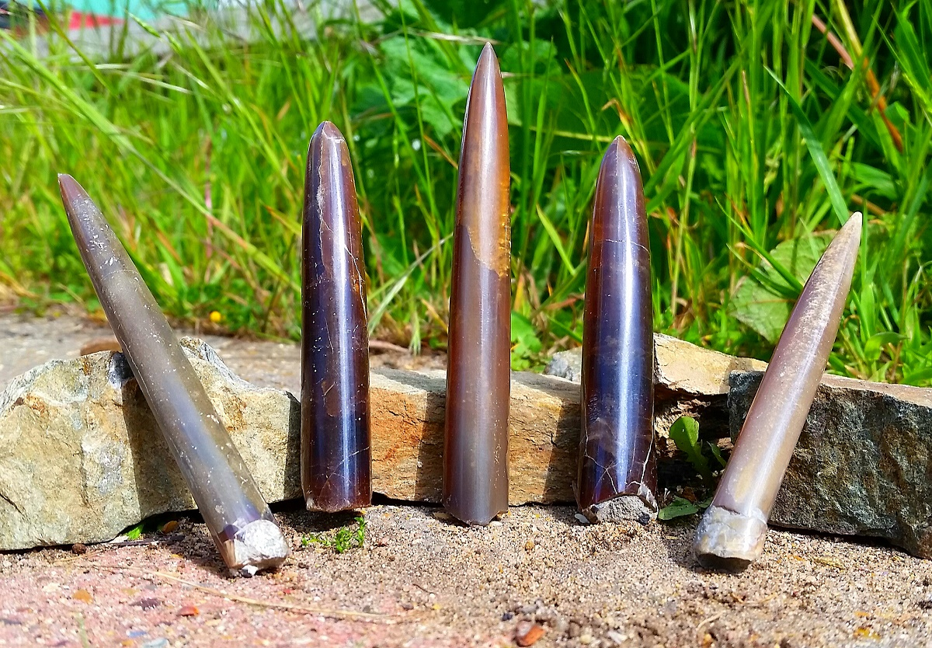

Slide 6
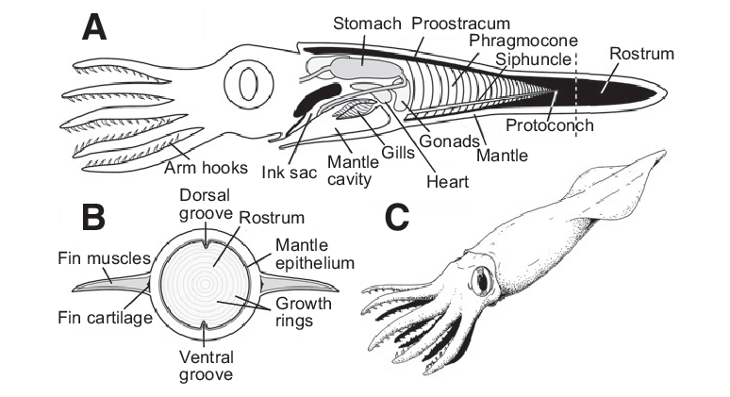
Belemnites
Iba et al 2012

Slide 7
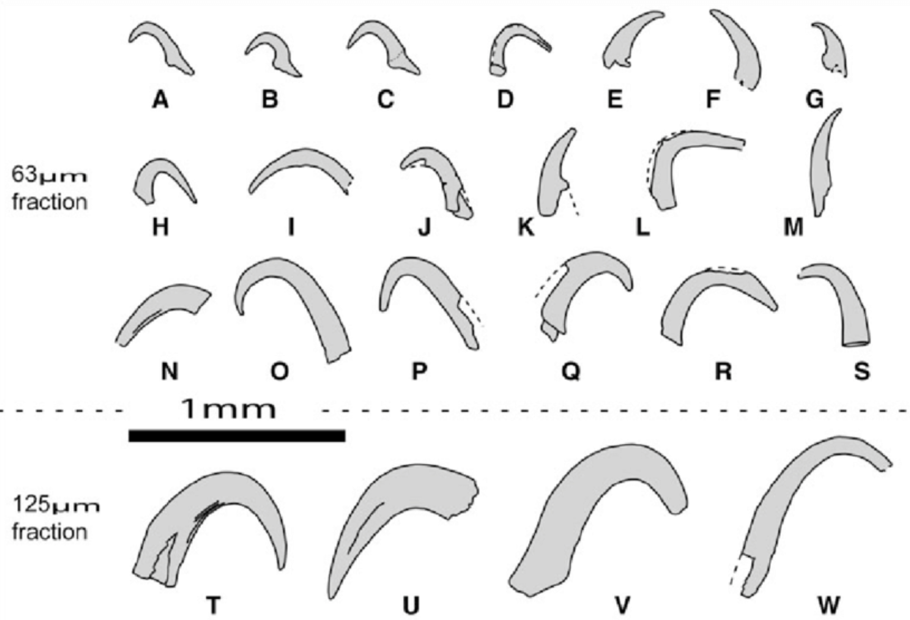

Slide 8
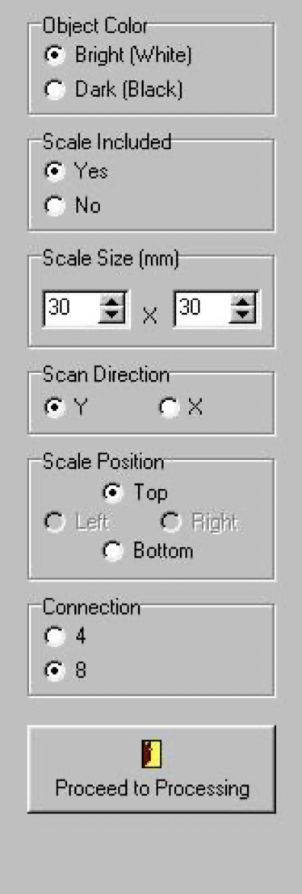
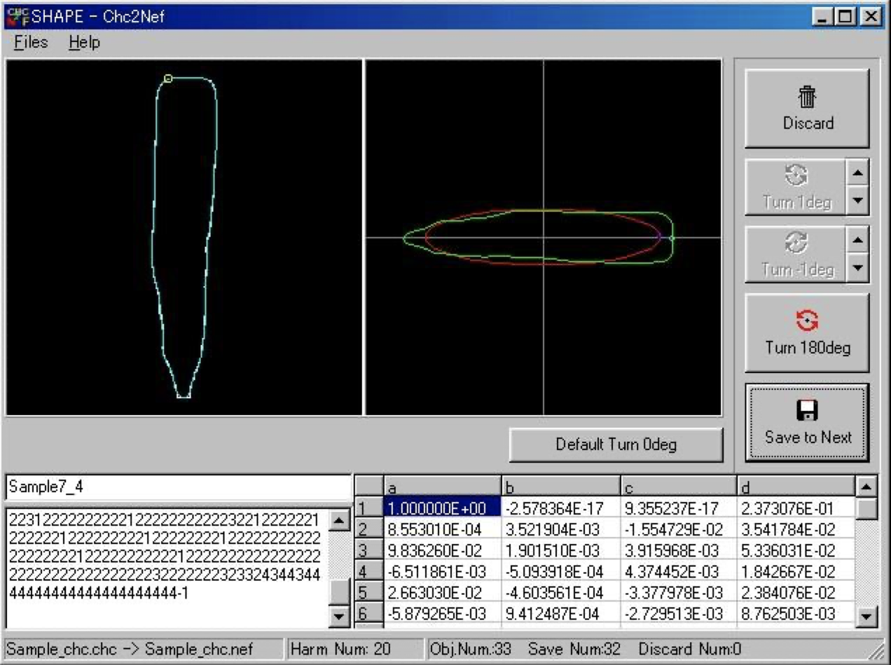
So how are we collcting the data?
SHAPE

Slide 9

SHAPE
Iwata, H., and Y. Ukai (2002) SHAPE: A computer program package for quantitative evaluation of biological shapes based on elliptic Fourier descriptors. Journal of Heredity 93: 384-385.
http://lbm.ab.a.u-tokyo.ac.jp/~iwata/shape/

Slide 10

Alternative:
Momocs R package
Custom code from Manuel F. G. Weinkauf

Slide 11
The workflow
Photograph Specimens
Binarize Photos
Digitize outlines
Create Fourier Decomposition
Analyze!

Slide 12
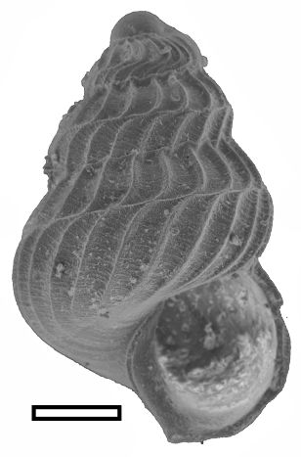
Photograph specimens

Slide 13
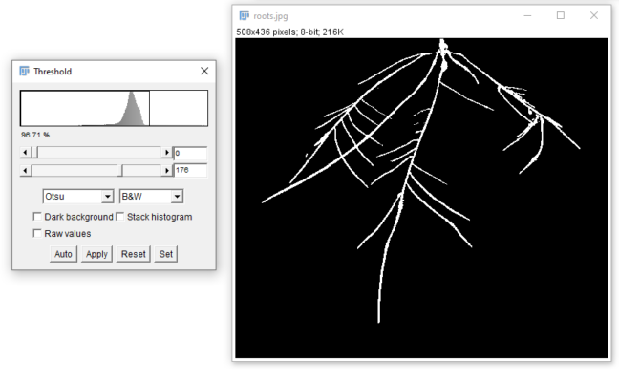

Binarize Images
FJIJI: Fiji Is Just ImageJ

Slide 14
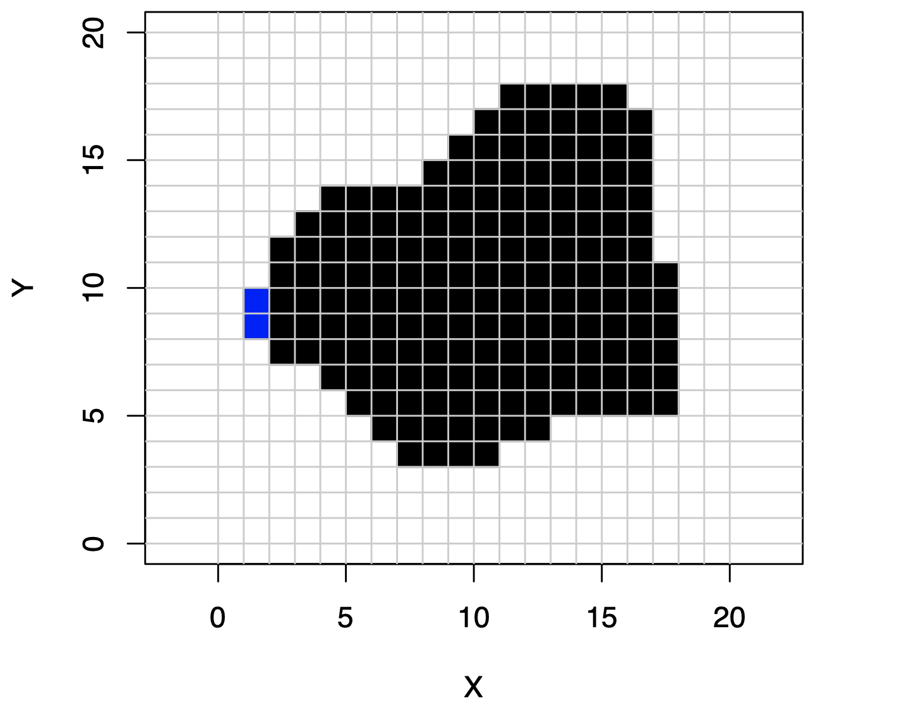
Homologous starting point

Slide 15
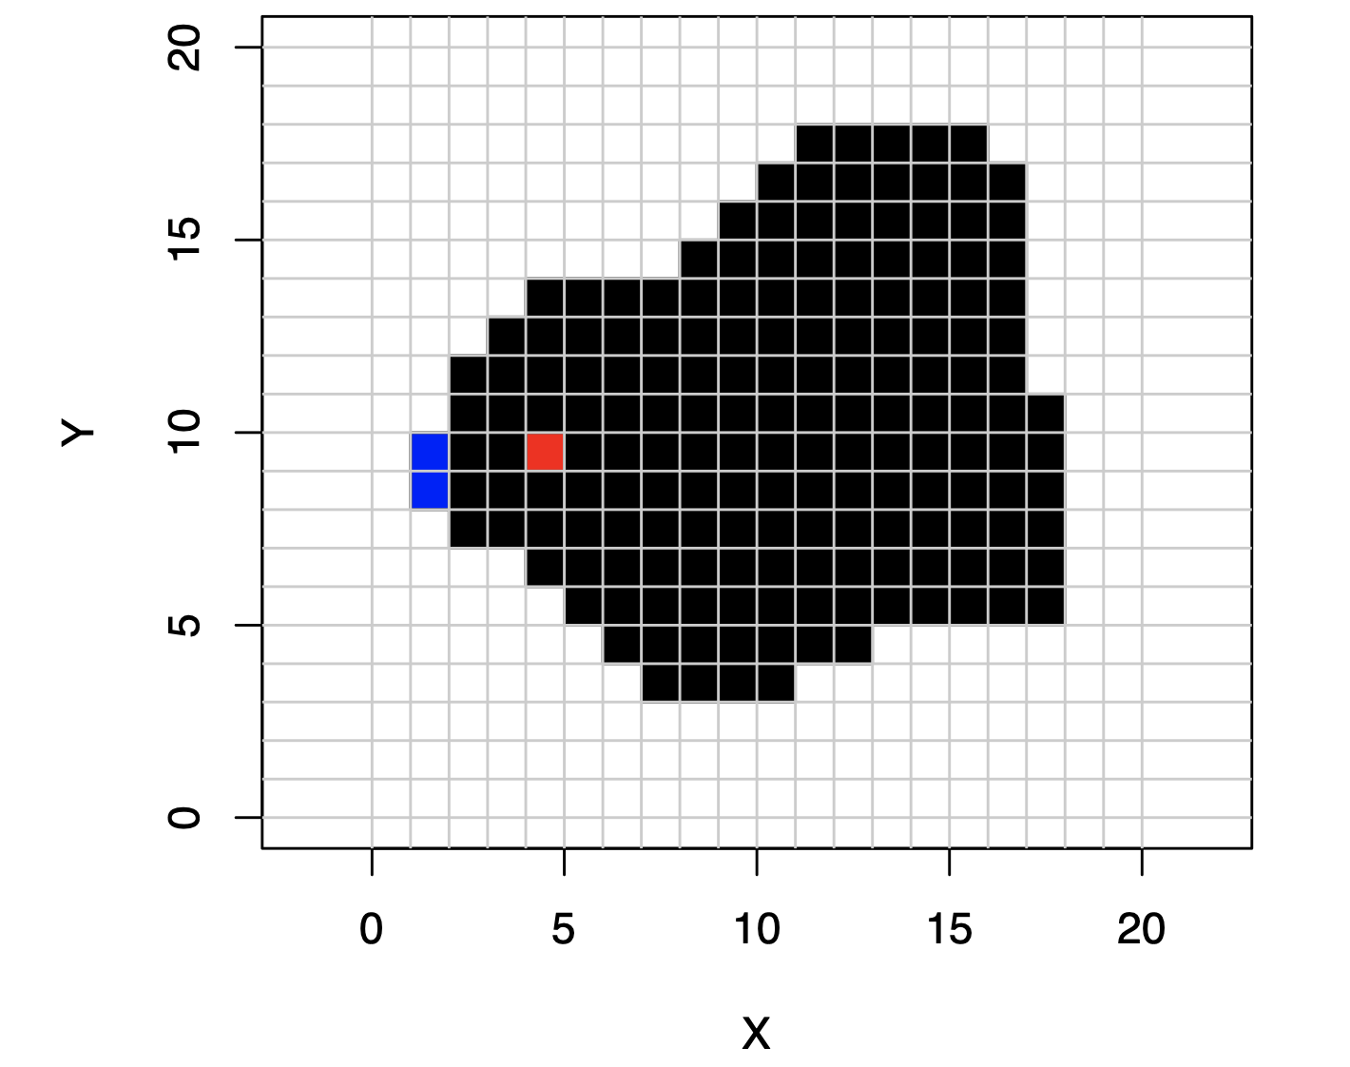
You click to the right of the starting point

Slide 16
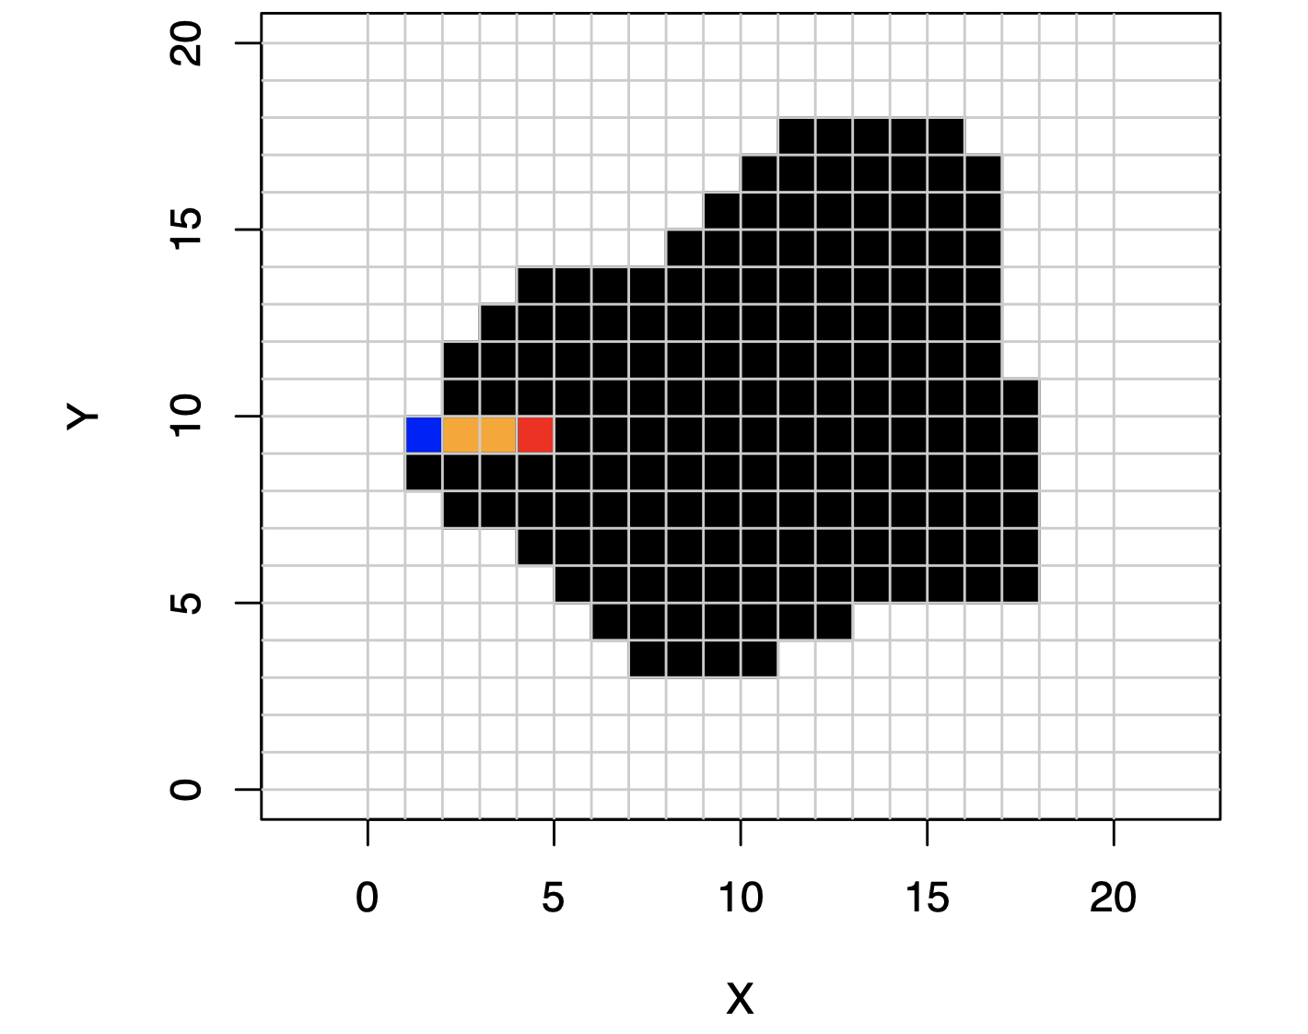
Algorithm walks directly to the left until the object boundary is found

Slide 17
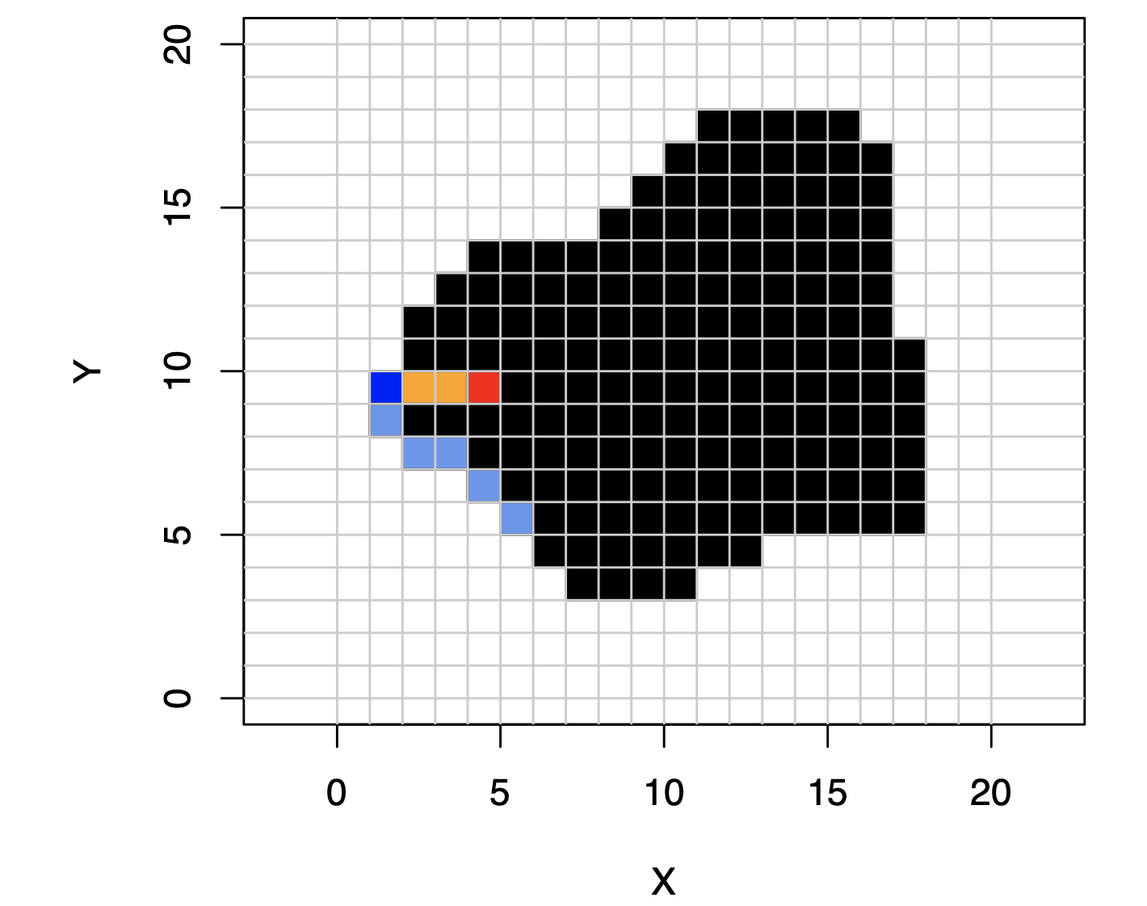
Algorithm walks around the border between object and background counterclockwise

Slide 18
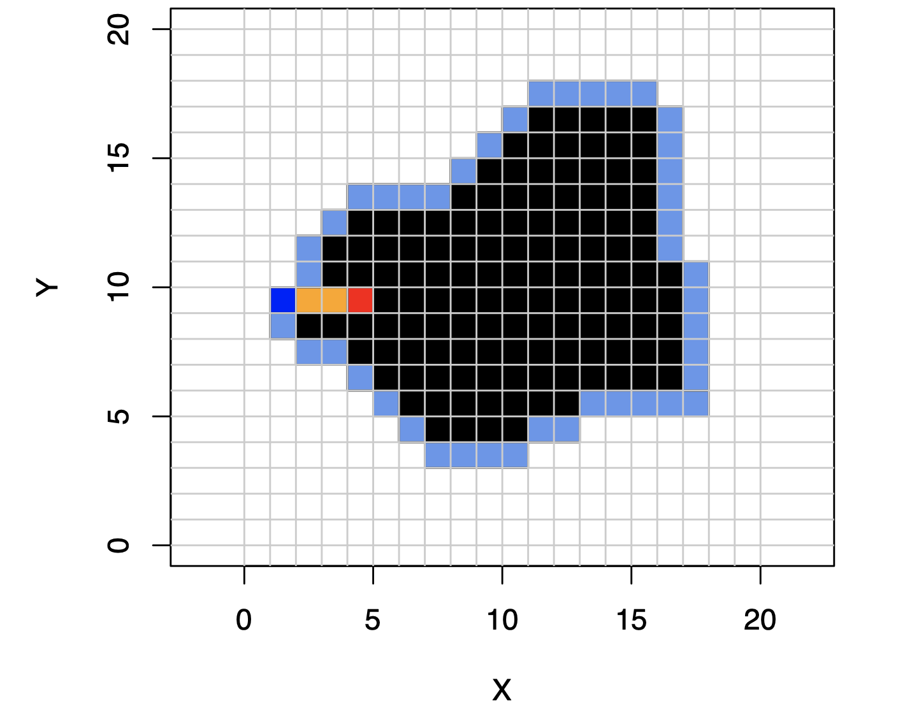
Until Entire outline is collected!

Slide 19
Image requirements
All specimens must be rotated to be roughly the same orientation
Homologous point has to be to the left

